Slide 1
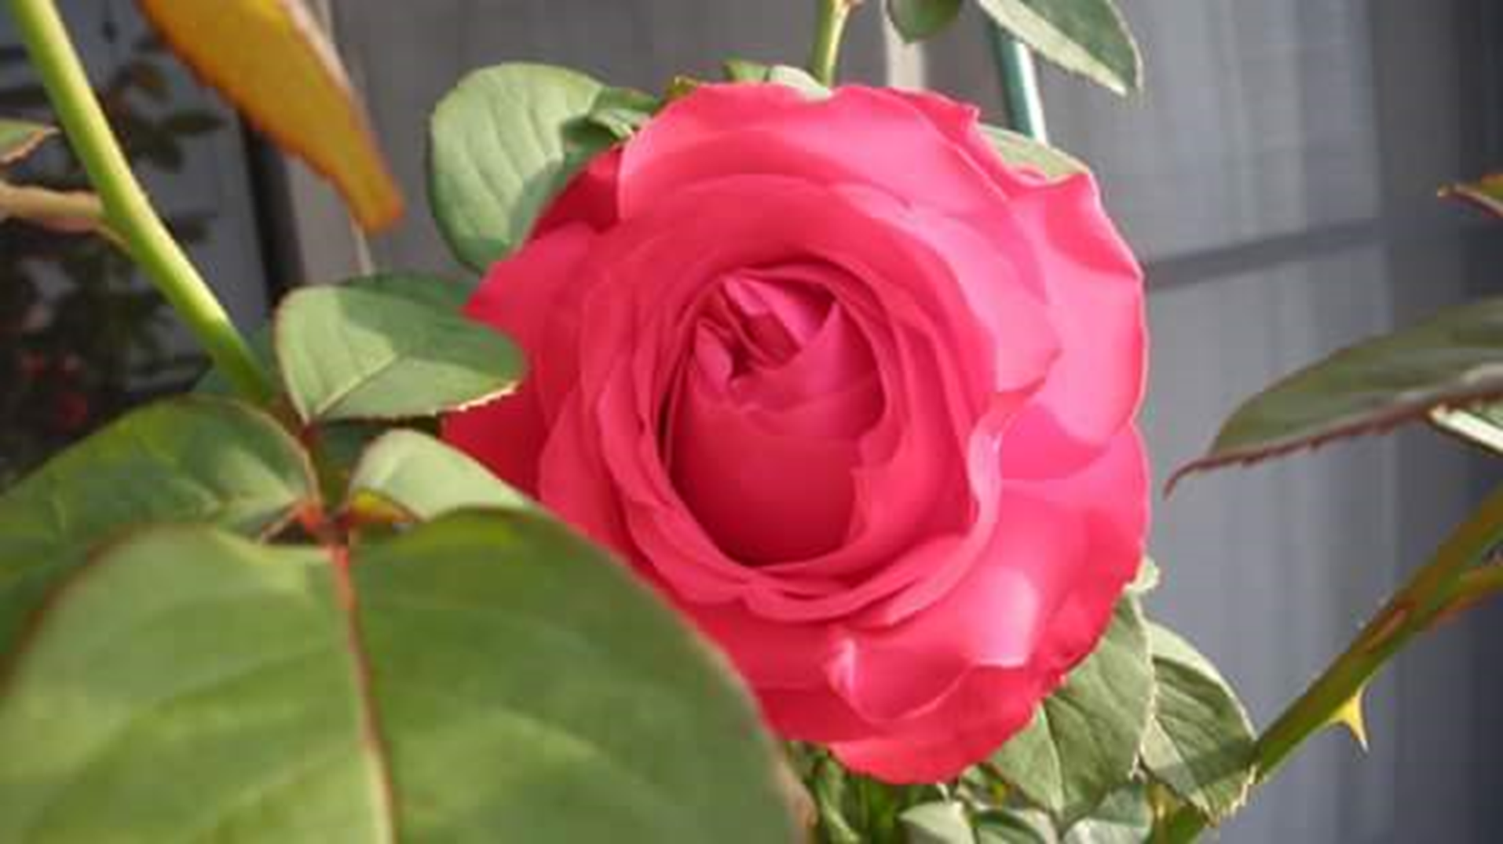
WELCOME

Slide 2
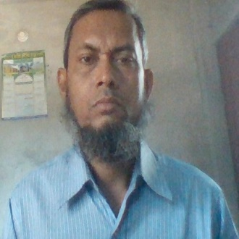
TEACHER IDENTITY
MD.ISMAIL HOSSAIN
ASSIST.TEACHER
BETHULIA GIRLS’HIGH SCHOOL
RAJBARI.

Slide 3
JSC
SUGGESTION
2017
ENGLISH
2nd paper

Slide 4
Section-A:grammar
Use of articles
Use of prepositions
Substitution table
Narrative style
Changing sentence
Capitalization&punctuation
Use of suffixes&prefixes
Right forms of verbs

Slide 5


Formal letter
An application for seeking permission to on a study tour/excursion
An application for a transfer certificate
For a seat in the school hostel
For morning school
For a testimonial
For a day’s holiday
For constructing
For a full free-studentship
For setting up a canteen
For early leave
For leave in advance
For admission TC
For remission of delay fine
For permission to arrange a friendly football match

Slide 6
EMAIL
An email to the railway booking clerk for asking him to reserve a seat for you
An email to bank manager for cancelling a Cheque
To open a bank account
To school authority to the information about admission
To open a relief camp on the school premises
To repair a damaged road
For thanking your friend for sending a nice birthday gift
To your father about your preparation for the JSC examination
For thanking your friend for his /her hospitality
About your aim in life
To your friend congratulating him on his brilliant success
To your friend to join the picnic
To your father to send some money
To your friend describing the accident that you havewitnessed
To your fried telling him about apicnic you enjoyed

Slide 7
compsition
A journey by Boat
Your aim in life
Your Favourite hobby
Wonders of modern science
The season you like most
Floods in Bangladesh
Physical exercisediscipline
Value of time
Your native village
Your daily life
Your child hood Memorise
Your first Day at school
The rainy season in Bangladesh

Slide 9
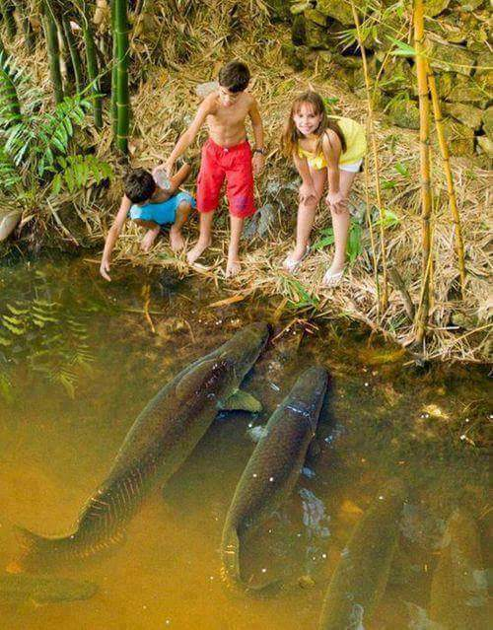
THANK YOU A LOT

